Slide 1
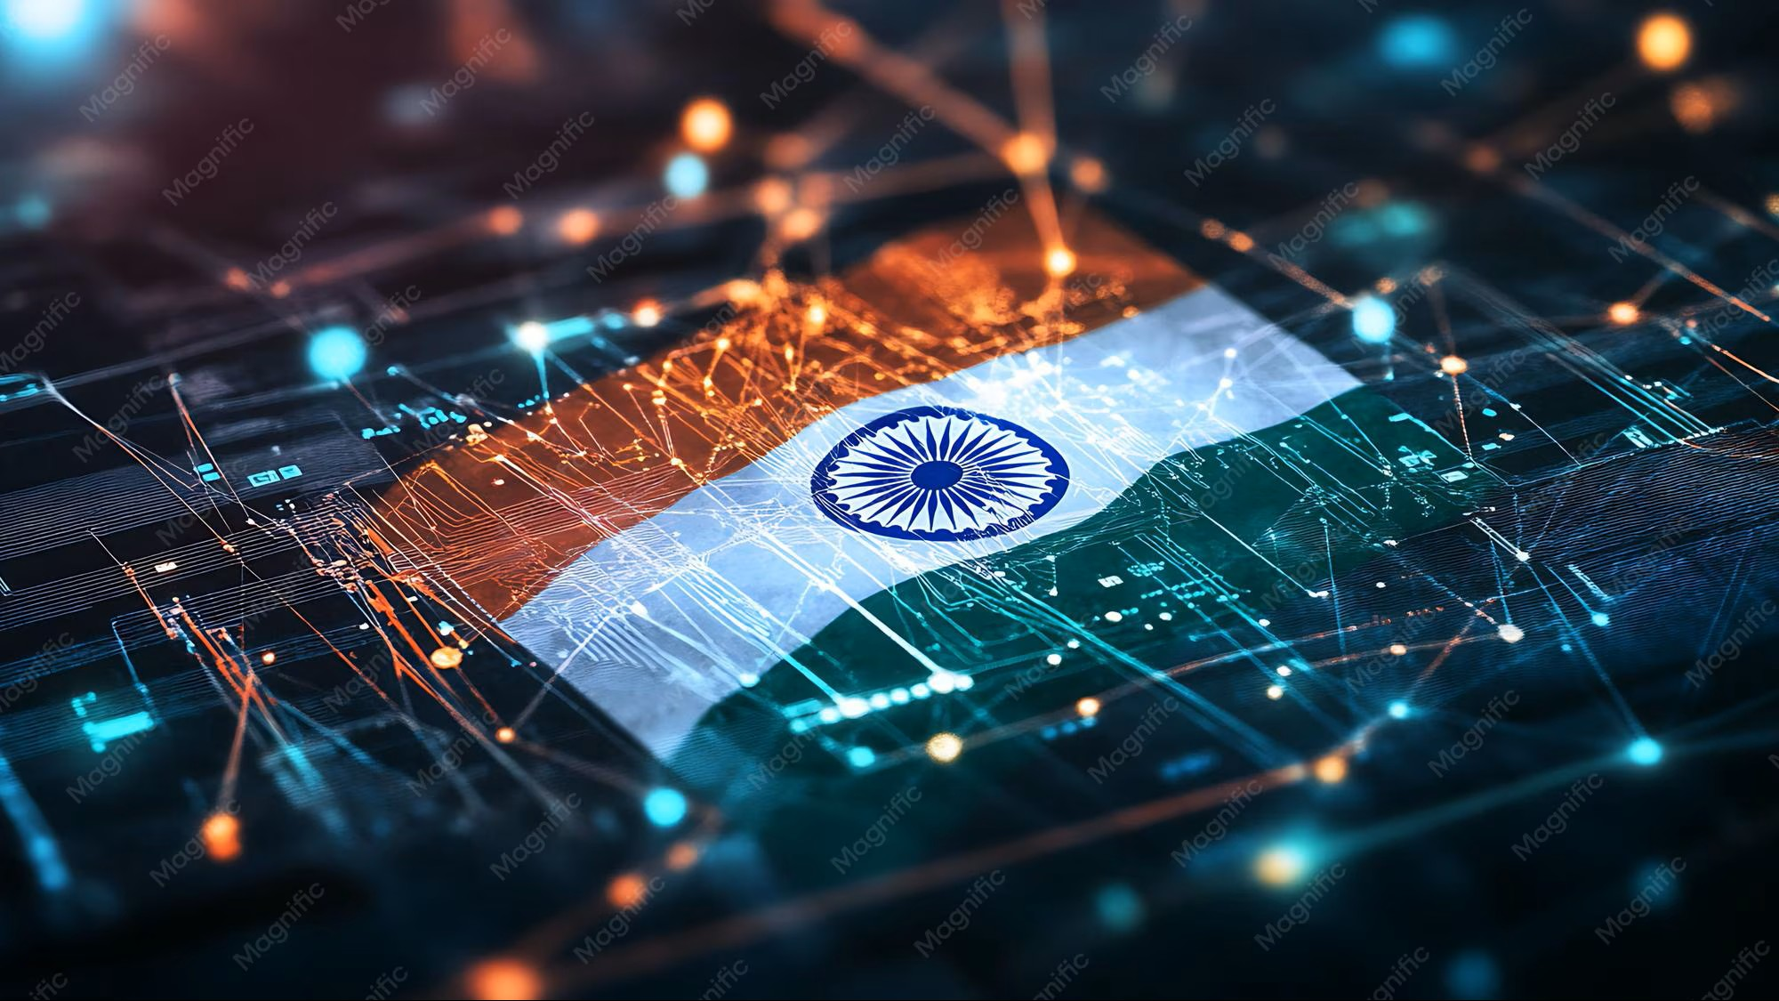

DIGITAL INDIA
Technology for Better Future
Presented by: Khushi Maurya
Trade: AIPA
NSTIW Allahabad

Slide 2
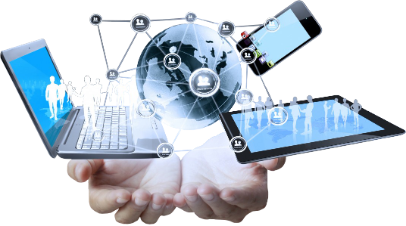
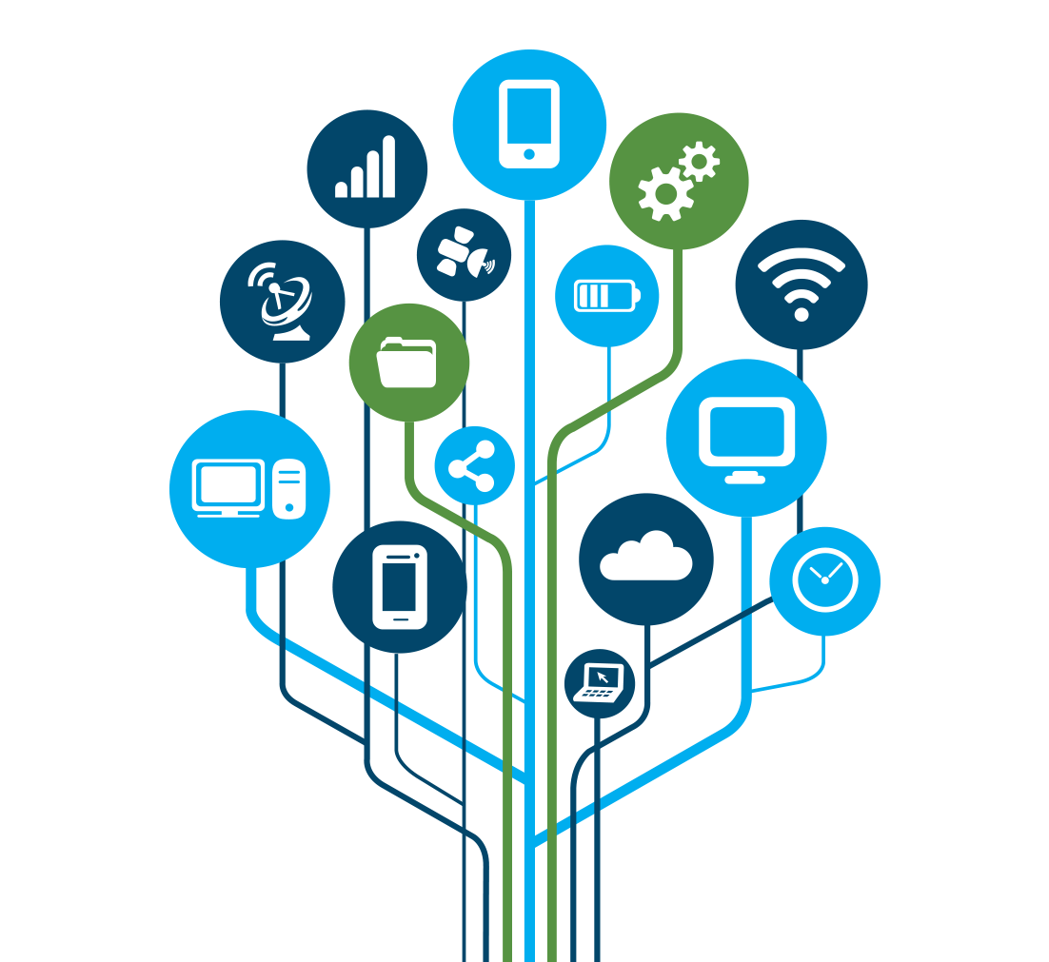
What is Digital India ?
Digital services for citizens
Online government services
Digital payments
Digital infrastructure
Technology-enabled education.

Slide 3
Major Areas of Digital India
Digital Payments
E-Governance
Digital Education
Digital Healthcare
Online Banking
Digital Infrastructure

Slide 4
Digital Services We Use
Internet
Mobile
Online Services
Digital Payment
Digital Certificate

Slide 5
Digital Payment Method
Payment Method | Example
UPI | Mobile payment
Debit Card | Card payment
Credit Card | Online payment
Net Banking | Bank transfer
QR Code | Scan & Pay

Slide 6
Growth Of Digital Payment

Slide 7

Benefits Of Digital Technology
Saves Time
Easy Access
Transparency
Convenience
Wider Connectivity

Slide 8
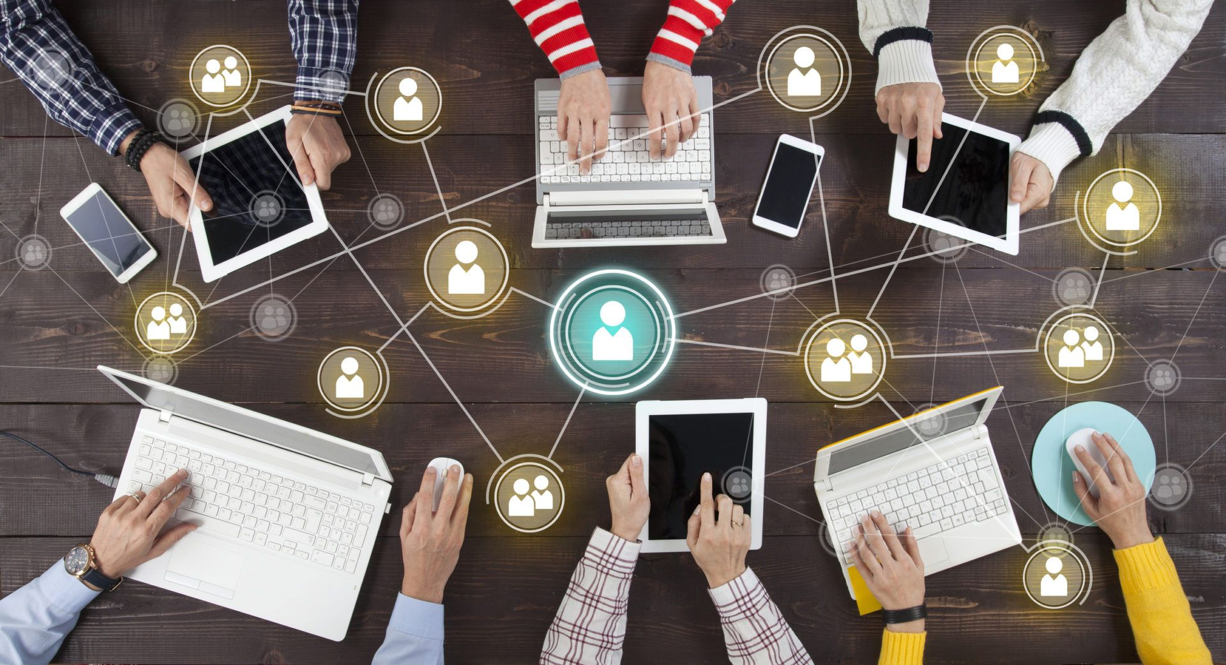
Create a visually attractive diagram showing
🔐 Cybersecurity
🔒 Data Privacy
🌐 Digital Divide
📱 Digital Literacy
⚠️ Online Fraud

Slide 9
Future Of Digital India
Create a Timeline
Today
Digital Services
Digital Healthcare & Education
Technology-enabled services
5G Connectivity
Faster Communication
Secure Digital India
Safer digital future
Smart Cities
Connected urban services

Slide 10
Conclusion
Digital India has transformed the way people access services, communicate, learn and make payments.
Technology is helping India move towards a more connected, smart and secure digital future.

Slide 11


